Slide 1
33 – Back-End Dynamic Content
COMP 256 – Dickinson College
Prof. Braught
Spring 2022

Slide 2
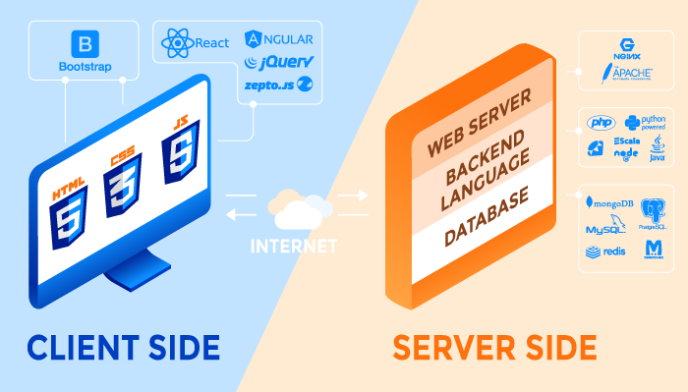
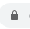
Typical Elements of a Web Application
http
https
Front
End
Web APIs
Back
End
Image from: https://rubygarage.org/blog/technology-stack-for-web-development
Notes:
Today Back-end languages
The web server as we have seen it
- serves up html/css/JavaScript in response to requests from the front-end.
- That has been static content in the web pages (.html files) thus far.
But we saw when looking at API’s is that some requests contain dynamic content.
- We saw we can request weather data for a zip code
- the server will not have a separate file for each zip code sitting there
- it generates that information dynamically by running programs.
- And almost always those programs get their data from a database.
- As we saw last class getting data from the database (at least and RDBMS) uses SQL.

Slide 3
Back-End Content
Static:
Files (HTML / CSS / JS / Images / Sounds / Videos / text / JSON / XML / etc.)
Read from a file and served, as is, back to the requestor
Dynamic:
Content (HTML / CSS / JS / Images / Sounds / Videos / text / JSON / XML / etc.)
Does not exist in a file
Generated as output from a back-end program
Frequently involving a database
Everyone gets the same files.
Customizable e.g. date, location, profile, query parameters etc. The content served is created specifically for each request.
Notes:
So, we can divide back end content into two broad categoreis:
Static
Dynamic
Static Content: Web server serves static content all on its own.
- These are just files that sit on the server
- They contain HTML/CSS/JS source code
- They may be images, sounds, videos or JSON/XML etc
- they are sent back to the client as is.
- The URLs from the client requests a specific file
- Server receives the request
- reads the file
- returns the result
- This is what the web server you will be writing in lab does.
- Cannot be customized or changed on the fly (i.e. everyone gets the same thing)
Dynamic Content: Web server hands off the request to a program that is run on the server.
- That program processes the request and generates a response
- The content of the response can be, and often is, exactly the same type of stuff as static content.
- But here the content here does not entirely exist in a file
- Instead, the back-end program runs and produces the content
- This allows the content to be customized to each request.
- using date / time / location / profiles / query parameters, etc…
- Typically, the running program uses a database to get the information it uses to generate the response.
All of the content types are the same.
- just where it comes from is different
- Static – it is just read from a file as is.
- Dynamic – it is generated by a running back-end program
- Which might include reading some content from a file and adapting.

Slide 4
Back-End Dynamic Content
Dynamic content on the back-end is generated by applications that run on the server in response to requests.
Three approaches:
Page Generation
Server Pages
API Endpoint Handlers
Notes:
As just described dynamic back end content is generated by a program running on the server.
There are three general ways in which this is accomplished:
- Page Generation
- Server Pages
- API Endpoint Handlers
We’ll look at each of these.
- We will briefly see Page Generation and Server Pages
- Really just want the concept
- We’ll dig more into API Endpoint Handlers
- This is the most common approach used for modern web applications.

Slide 5
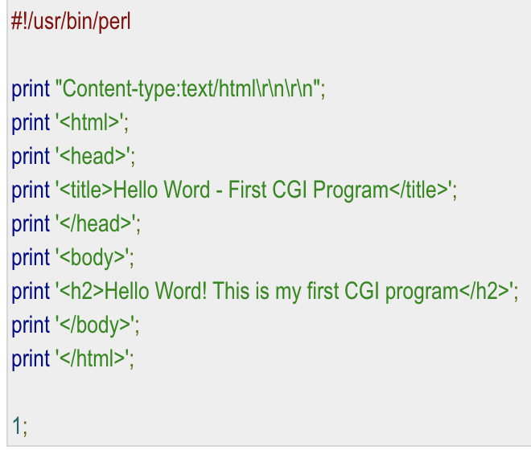
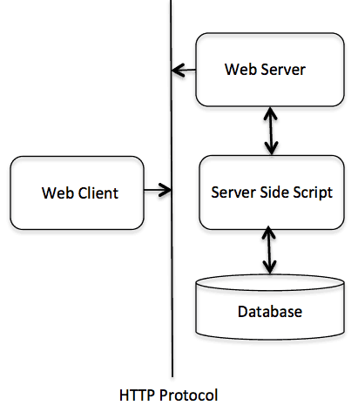
Page Generation
With page generation a program/script run on the server that outputs an entire web page.
Common Gateway Interface (CGI)
CGI Scripts (Bash/Perl)
Java Servlets
CGI
Notes:
Page generation is the oldest technique for creating dynamic content
- Nearly as old as the web.
- The most basic way to do this is called CGI
- Common Gateway Interface
- that is a way by which a web server will recognize certain URL’s as programs to be run rather than pages to return.
- When the server receives a request for one of these URLs
- it simply runs the program
- returns whatever output the program generates as the response.
- The program can do whatever it needs to do.
- Perform a computation
- Read files
- Access a database
- etc…
The example here is in the language Perl that is common for these scripts.
- But they can literally be written in any language
The CGI Figure illustrates this process:
- A client sends a request for a url
- if the server recognizes that URL as a program to run instead of for a static page
- The server will make a system call to OS asking it to run the script corresponding to the URL
- May be run as a process or maybe a thread – depends on the specific tech being used.
- That script may then use database to get content for the page.
- The script generates a full HTML page including any content from the database.
Java Servlets are the same idea
- the mechanism is a little different
- but they are a java class that generates a web page as its output.
- server plug-ins know how to find and run the Java class.
As you can imagine it gets to be quite tedious writing these pages…
- That’s where server pages come in…

Slide 6
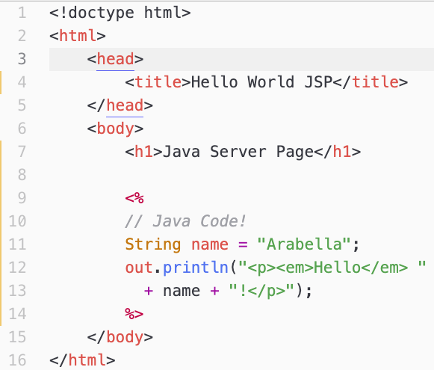
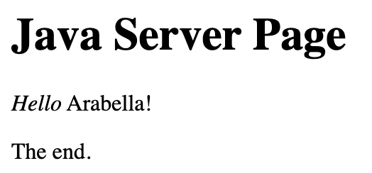
Server Pages
<% … %>
JSP Tags
With server pages a script is embedded into an HTML source file (using special tags) and the output generated by the script becomes part of the page.
Java Server Pages (JSP)
Active Server Pages (ASP)
PHP Hypertext Preprocessor (PHP)
Notes:
With server pages you embed small bits of script inside of otherwise static pages.
When a client requests a server page
- The server processes the page
- It runs any bits of embedded script
- and then substitutes the output of the script for the script source code in the HTML page.
- This saves the developer from writing print statements for the entire page as they had to with page generation,.
Server Pages are a nice Abstraction:
- They let the developer focus on the dynamic parts of the page
- While ignoring how the full page is generated.
The example shown here is available in our container as: comp256/jsp1.jsp

Slide 7
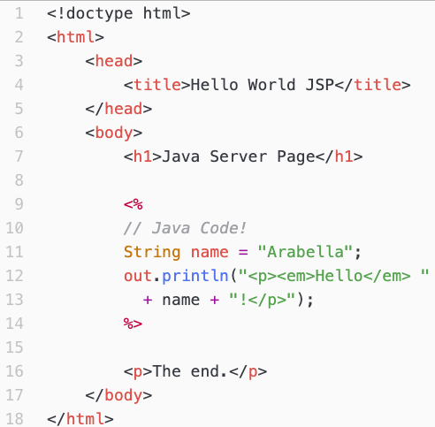
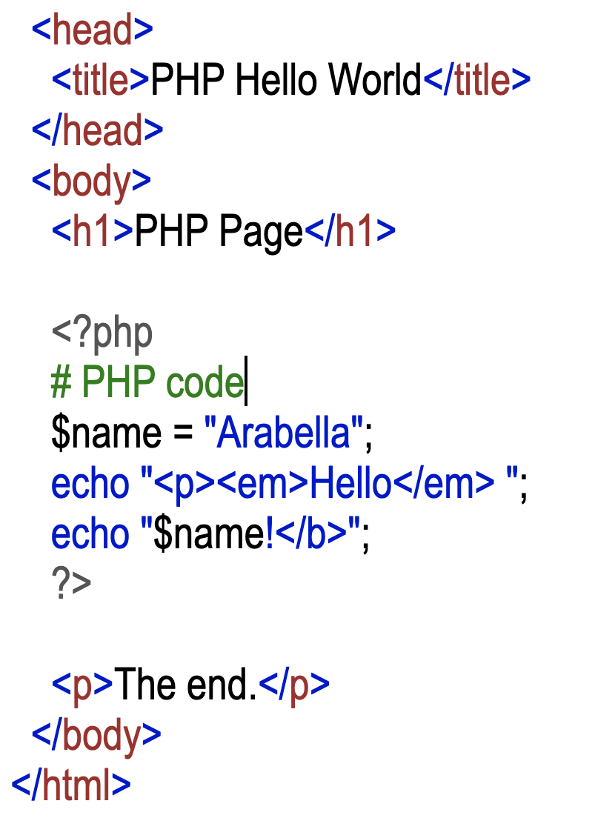
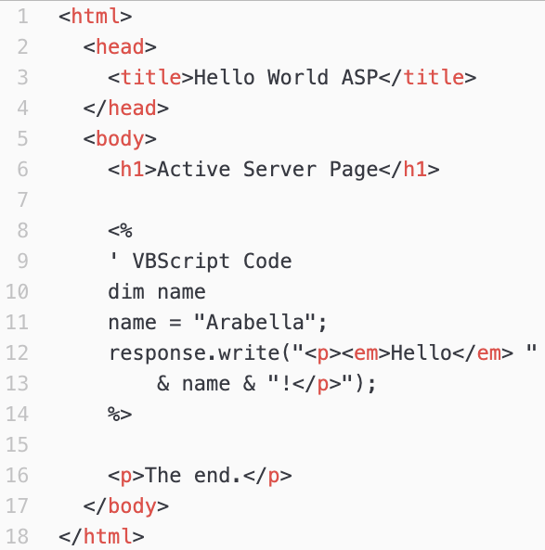
Some Server Page Technologies
JSP
PHP
ASP
Notes:
There are lots of different Server Page technologies.
But they are all fundamentally the same…
- They just embed scripts within otherwise static HTML code.
- The Server just runs the stuff in the script tags and substitutes the output that it generates into the HTML page that is returned.
- JSP: Java Server Pages
- is just as we saw on the prior slide.
- PHP does the same thing
- It just uses different tag
- and uses PHP language syntax
- e.g. echo instead of out.println
- ASP: Active Server Pages
- A Microsoft Product that worked in their web server.
- Uses the same tag as JSP
- But the embedded script is written in VisualBasic Script (VBScript)
There are a few more complex examples of a JSP in our container if you are interested:
- nameJSP.html and jsp2.jsp
- nameJSP.html uses a web form to send query parameters to the jsp2.jsp page.
- the jsp2.jsp page then uses embedded Java to incorporate those query parameters into the page content.
- companyJSP.html and jsp3.jsp
- companyJSP.html uses a web form to allow the user to specify a country
- It passes that country to jsp3.jsp as a query parameter
- jsp3.jsp uses the query parameter to build an SQL statement that accesses the sample database.
- That SQL query returns a page that lists the names of all of the customers in the specified country.

Slide 8
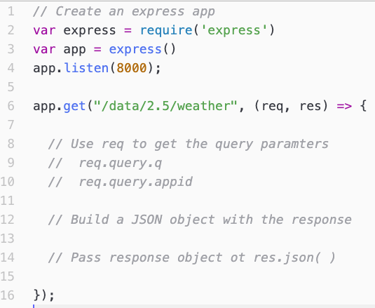
API Endpoint Handlers
In API Endpoint Handling the query string is routed, based on the service, to a function that generates the response.
Node.js/Express (JavaScript)
Laravel (PHP)
Flask / Django (Python)
Spring (Java)
ASP.NET (C#)
Notes:
We have seen API endpoints from the client/front-end
- A request in the form of a URL is sent to the server
- The server responds with some data
- Often in JSON format.
- We saw this when we used the OpenWeather API
- We sent a request to:
- The server: api.openweathermap.com
- The endpoint on that server: /data/2.5/weather
- With query parameters specifying what we wanted and our API key giving us authorization to get it.
Today we’ll look at how API requests can be processed on the back-end and how they interact with a database.
Here we have an example of what this looks like using the Node.js / Express framework.
- Node.js and Express are just a programs and libraries that make it easy to write API handlers in JavaScript.
- Basically, for every endpoint you add a function that processes it.
- Here we are adding code the will process requests that come to /data/2.5.weather
- Those requests would roughly:
- Use the req parameter that the function receives to get the values of the query parameters.
- The Express framework makes sure that the req object containing the query parameters is passed to the function.
- That is all hidden from the developer.
- The function would then use those query parameter values to help it build a JSON object to return
- E.g. Containing the weather information for the location indicated by the query parameter q.
- It then returns that JSON object by passing it to res.json(…)
- The function res.json(…) is also provided by the Express framework
- The developer doesn’t need know know where it came from
- Just that when a JSON object is passed to it, that object is returned to the client as the response.
There are tons of other libraries and frameworks for writing API handlers
- One or more for just about any language you want.
- They all do essentially the same thing.
- Get the query parameters
- Generate JSON (or XML or whatever)
- Return it to the client
Abstraction:
- All the frameworks just setup routing so that the info gets to the right function,
- And that the response gets sent back to the requestor.
Example of what this looks like in Express.

Slide 9
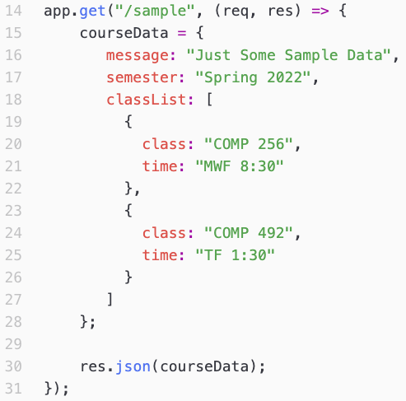
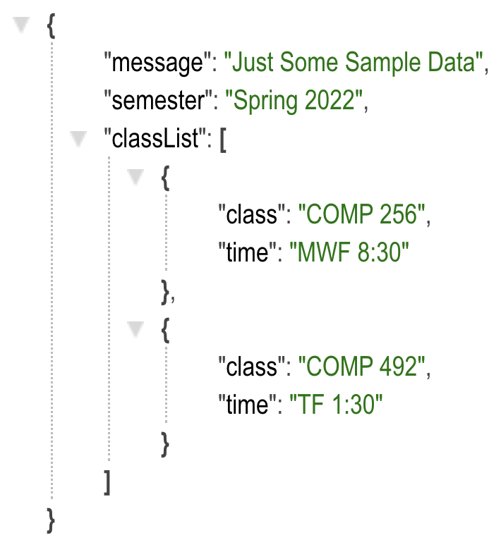
A /sample API Endpoint The Back-end Code
(northwindAPI/server.js)
Visit: https://localhost:8000/sample
Notes:
Here is a simple example of how an endpoint can be created in Express.
- The point is just a first example
- We’ll see one that does something more interesting and dynamic in a minute.
This code handles requests that come to the /sample endpoint.
- Shown highlighted in orange.
The code in the function
- Shown highlighted in blue.
- It generates a JSON object (coruseData)
- And sends it back to the client as the response (call res.json(…))
We can see this in our container if we put the URL for a request to /sample into the browser:
http://localhost:8000

Slide 10
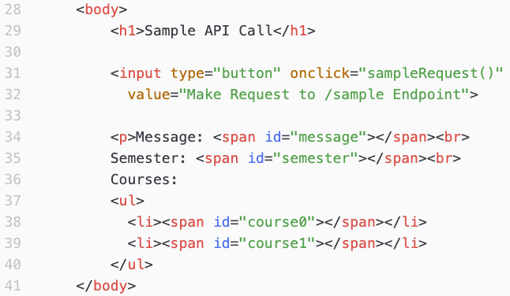
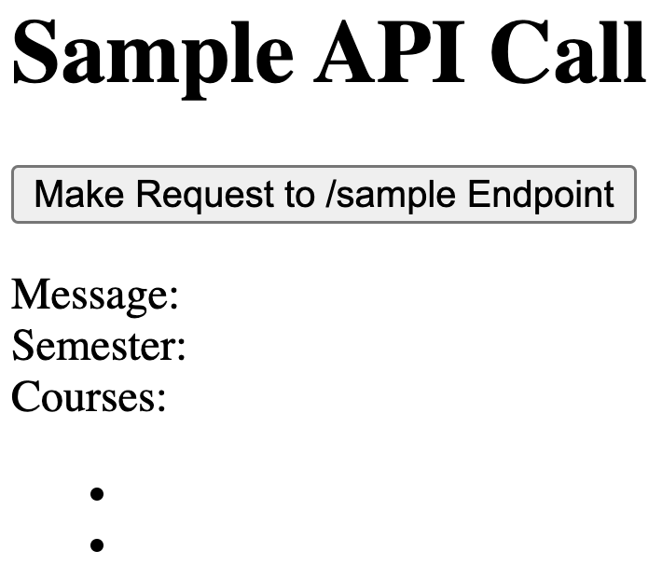
A /sample API Endpoint The HTML Code (comp256/api2.html)
Notes:
We can also create pages that incorporate calls to this API:
WILL ADD MORE DETAILS SOON.

Slide 11
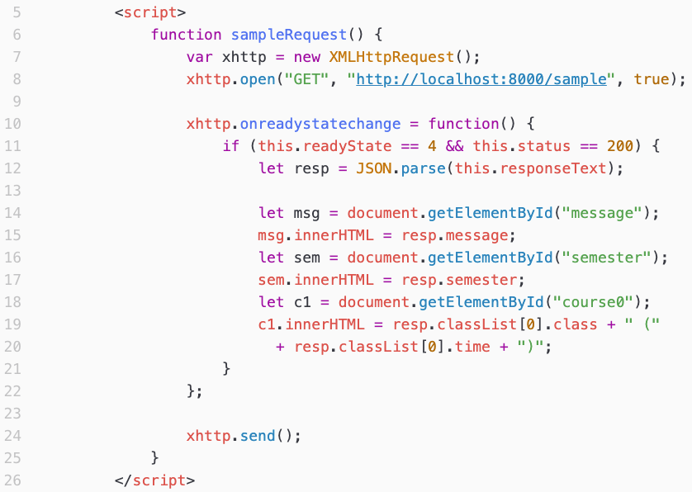
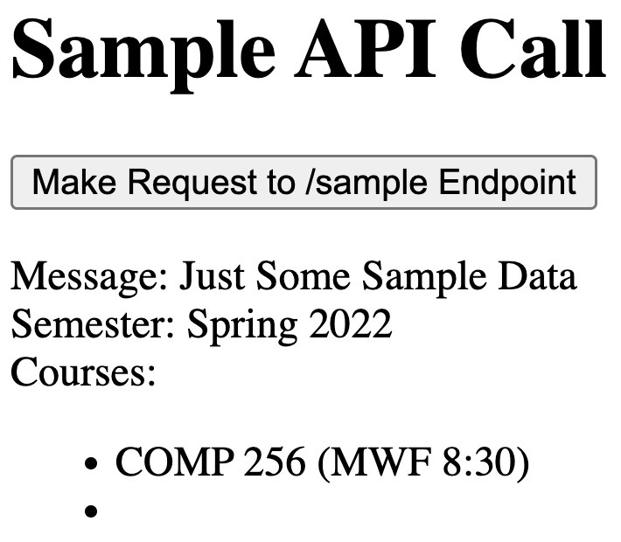
A /sample API Endpoint The Front-end Code (comp256/api2.html)
Notes:
The code that generates the request and then processes the response
- This is just like the code we saw in the API class
- So very similar to how we were making requests of Open Weather and processing its results.
- But now the request is going to our API hander.
WILL ADD MORE DETAILS SOON.
How can we display the second course?

Slide 12
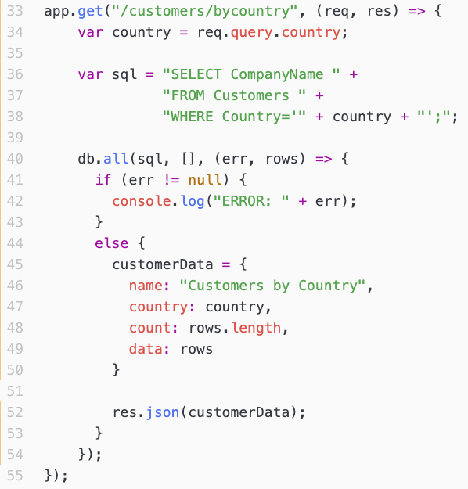
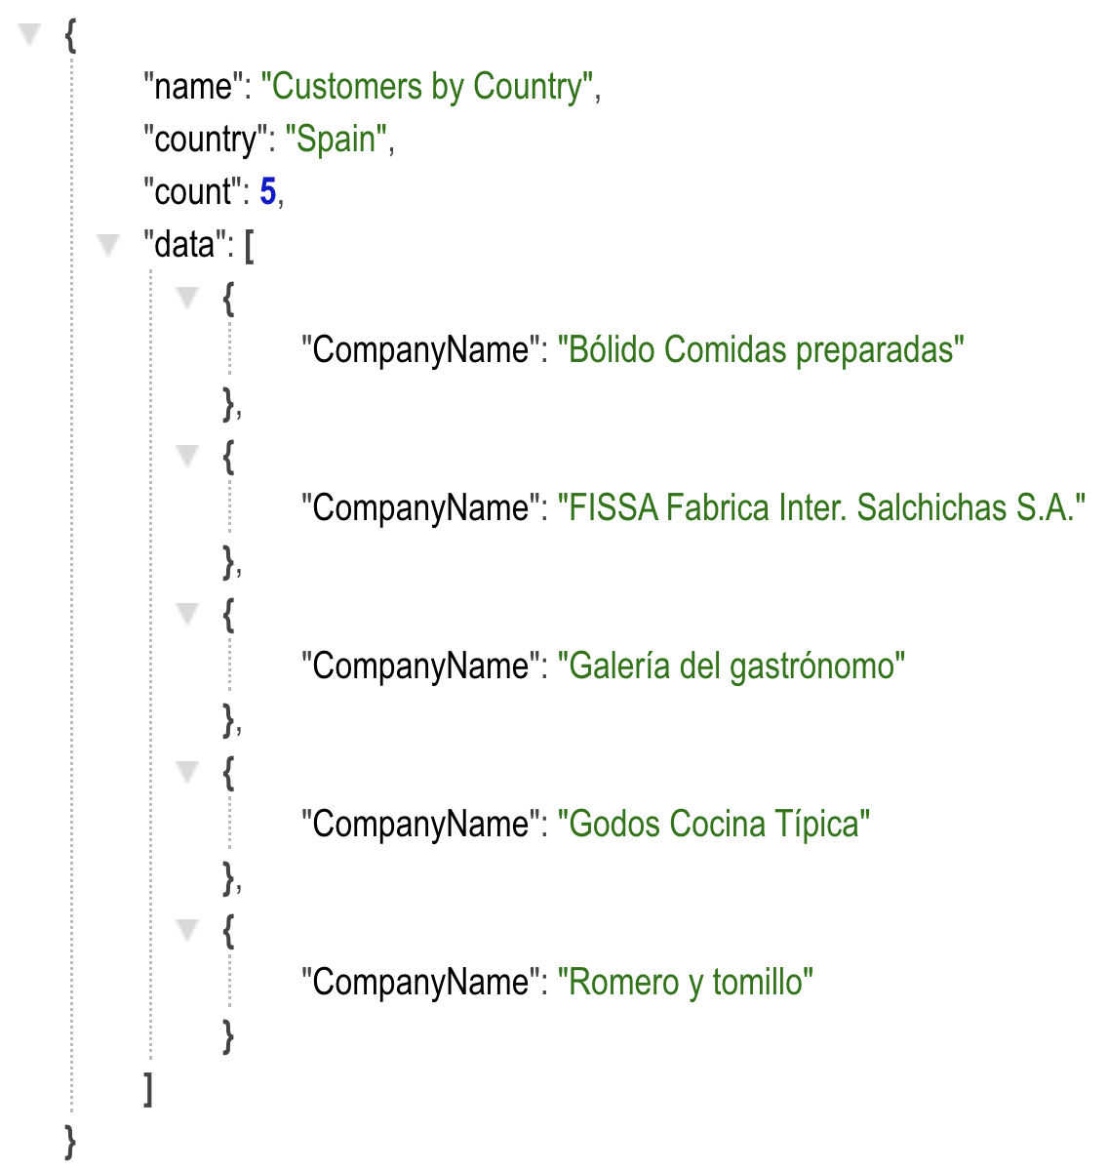
An API Endpoint that uses SQL The Back-end Code (northwindAPI/server.js)
Visit:
http://localhost:8000/customers/bycountry?country=Spain
Notes:
Our API handers can do more sophisticated things.
For example, they can make SQL queries and access a database.
WILL ADD MORE DETAILS SOON.

Slide 13
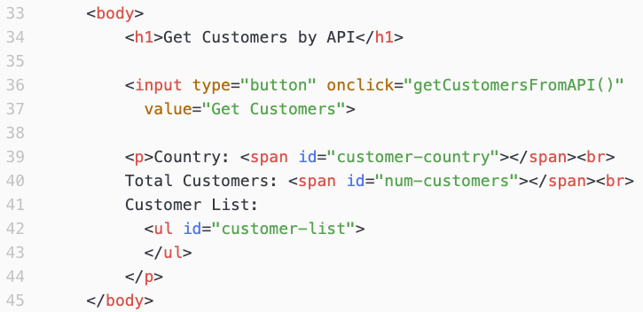
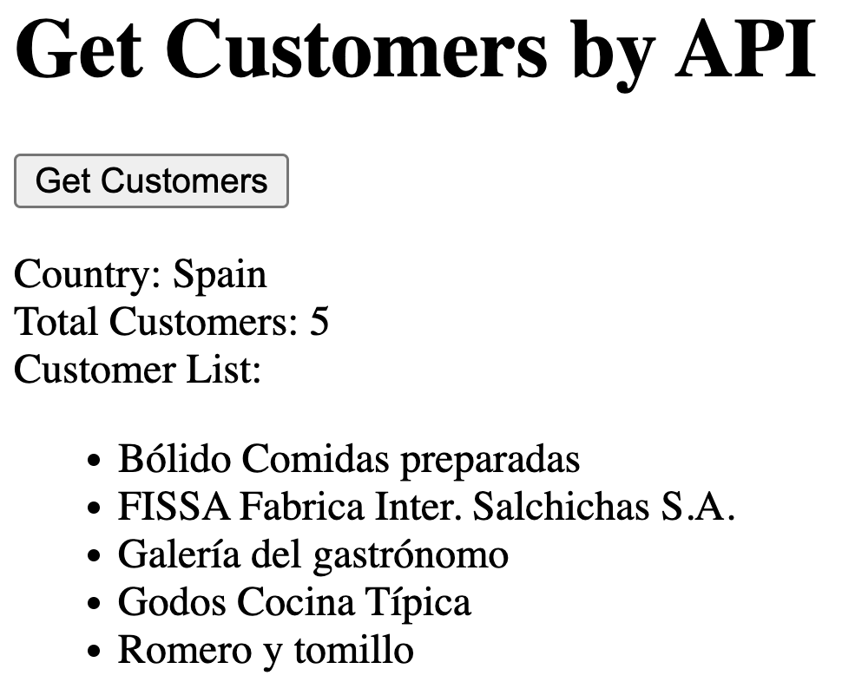
An API Endpoint that uses SQL The Front-end HTML
(comp256/api3.html)
Notes:
We can then make a page that makes a request and processes the results.
WILL ADD MORE DETAILS SOON.

Slide 14
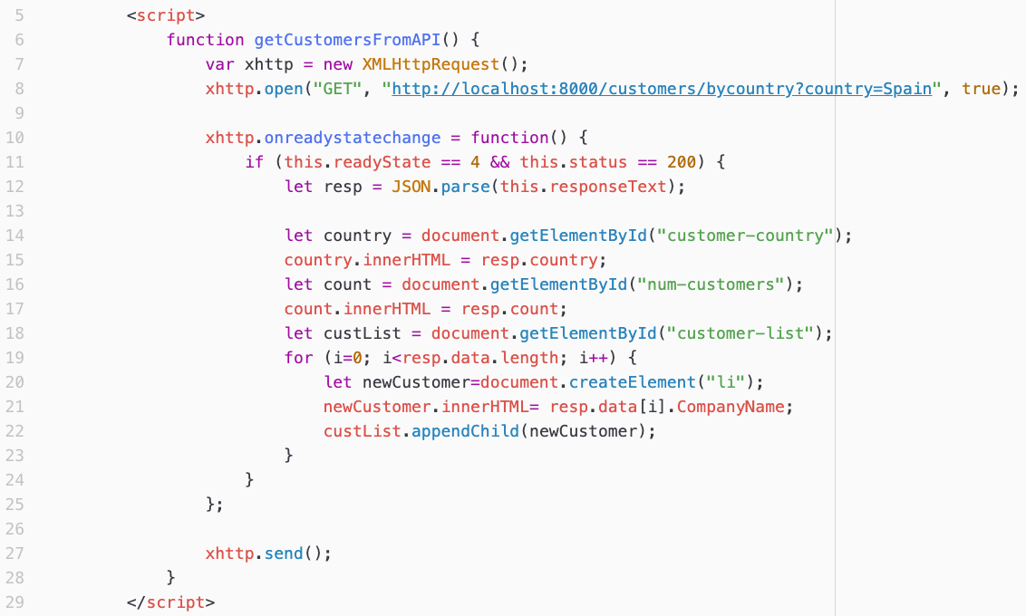
An API Endpoint that uses SQL The Front-end Code
(comp256/api3.html)
Notes:
Again the JavaScript is very similar to what we have seen in the past.
- The request is just different.
- The response JSON will be different
- So the way that we process the result is adapted to that JSON.
WILL ADD MORE DETAILS SOON.
How can we also get and display the city name?

Slide 15

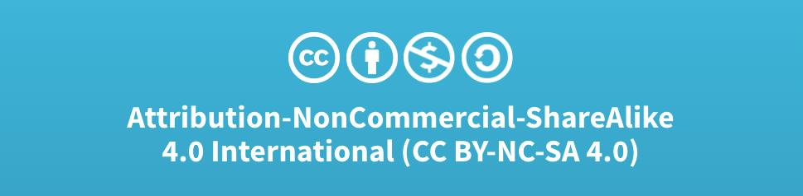
Acknowledgments
Slide Template From:
https://creativecommons.org/licenses/by/4.0/
Slide Content Licensed as:
Creative Commons Attribution-NonCommercial-ShareAlike 4.0 International License.
Notes:
Note: Individual images may be covered by their own licensing agreements and were incorporated here under fair use. Their use in this slide deck does not change or alter their licensing.

Slide 16
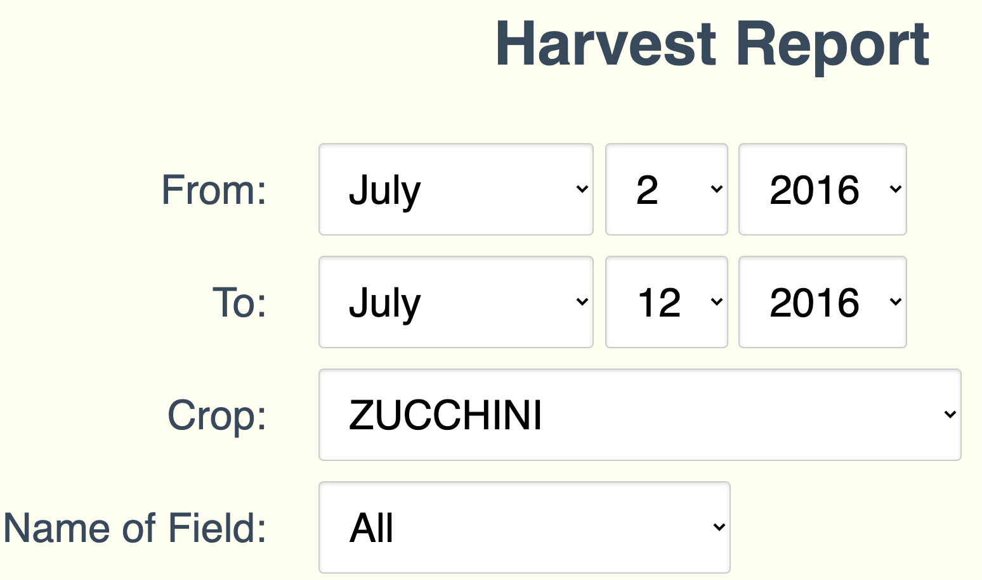
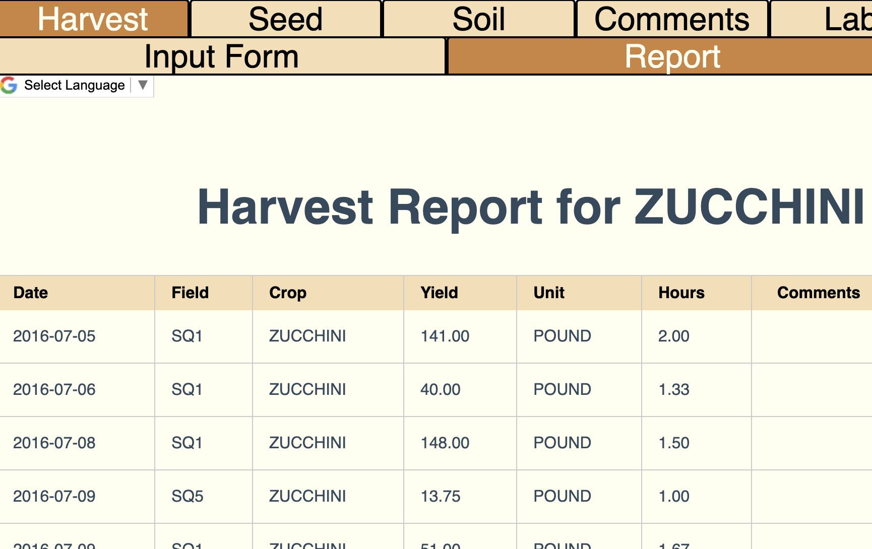
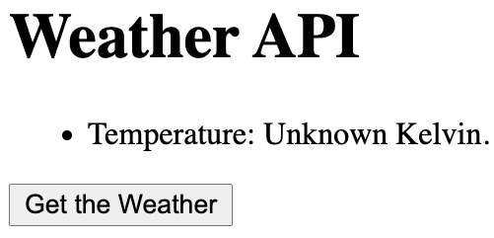
Examples:
Notes:
From the perspective of the back end
- our Weather page is static.
- everyone who loads that page gets the same thing
- it is just html, javascript read from a file.
FarmData is Dynamic
- Form is used to generate a request
- Information about what is wanted is sent to the server as query parameters.
- Server uses that to access the database
- Dynamically generates a static HTML page with the results
- Returns that page to the browser.
- There is not a page for every day, every crop, every field
- That would be silly.
- the page is built on demand by a program and returned.
Now you might be thinking...
- Getting the weather is dynamic
- and you’d be right…
- the step of making the API request is backend dynamic content.
- generating the response is dynamic and happens on the server.
Today, we’ll talk about that back end dynamic content
- some of the ways it is generated

Slide 17
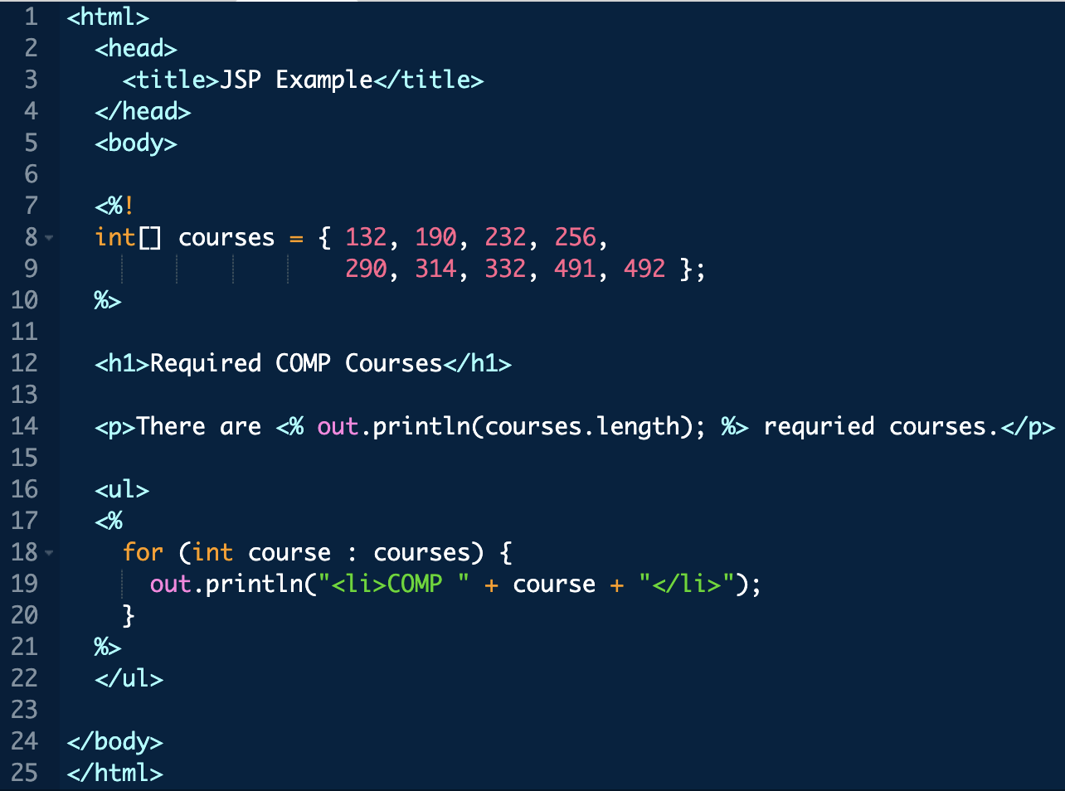
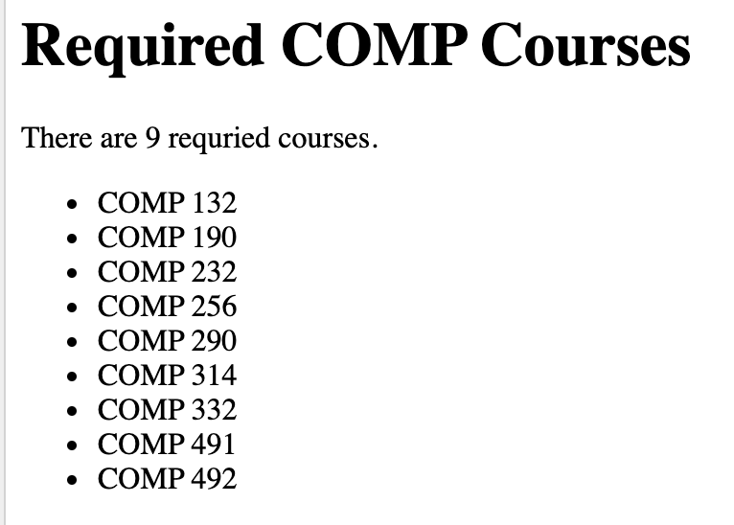
Another JSP Example
<%! … %>
JSP DeclarationTag
Notes:
Can interleave html and JSP blocks
Declaration block: <%! %>
Variables, functions, objects usable elsewhere.
Clever idea…
- Compiled to a java servlet that generates the whole page.
- static html becomes out.println statements
- other code stays code
- one big long main method
- compile it
- run it
- return page as output
- Fun extension to our web broswer… process JSP pages.
Abstraction
- Lots of println statements in servlets
- annoying and tedious for pages that are mostly static
- build an abstraction so you don’t have to do that stuff!
==
<html>
<head>
<title>JSP Example</title>
</head>
<body>
<%!
int[] courses = { 132, 190, 232, 256,
290, 314, 332, 491, 492 };
%>
<h1>Required COMP Courses</h1>
<p>There are <% out.println(courses.length); %> requried courses.</p>
<ul>
<%
for (int course : courses) {
out.println("<li>COMP " + course + "</li>");
}
%>
</ul>
</body>
</html>

Slide 18
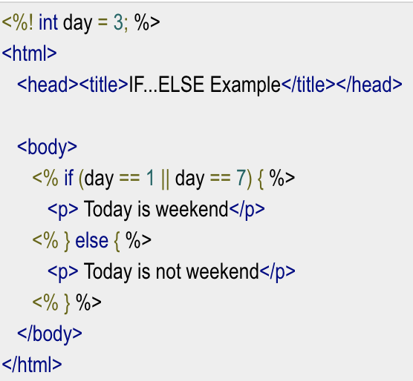
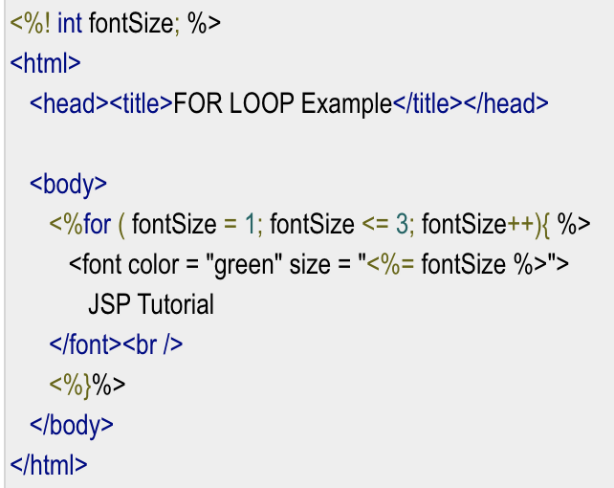
Mixing JSP and HTML
<%= … %>
JSP Substitution Tag
Notes:
Can intermix java and html
- every html line is just turned into a println
Also, in FOR example:
- <%=
- allows you to just use the value of a variable.
- don’t need to println

Slide 19
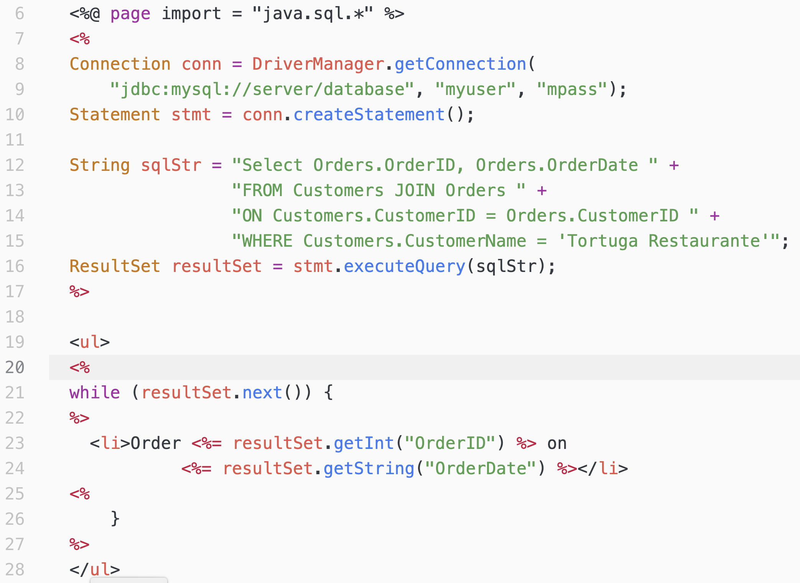
SQL in JSP via Java Database Connectivity (JDBC)

Slide 20
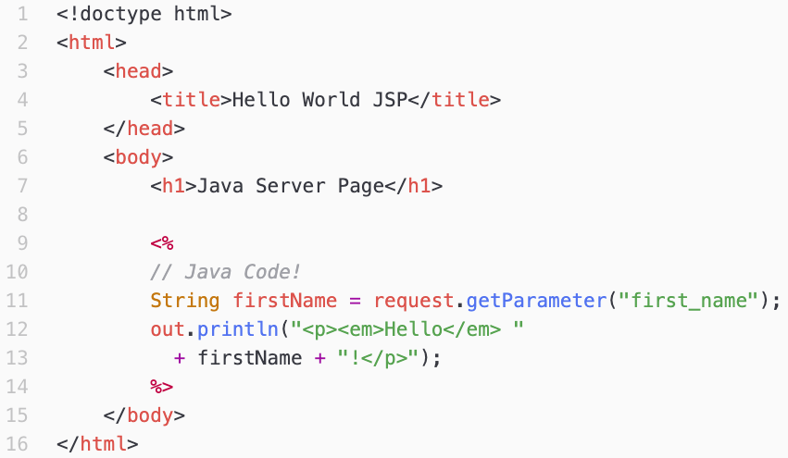
Passing Query Parameters to JSP
http://localhost:8080/comp256/jsp2.jsp?first_name=Zara
Notes:
comp256/jsp2.jsp
Demo by pasting the URL.
http://localhost:8080/comp256/jsp2.jsp?first_name=Zara
Request is an object defined in all JSP pages that you can use.

Slide 21
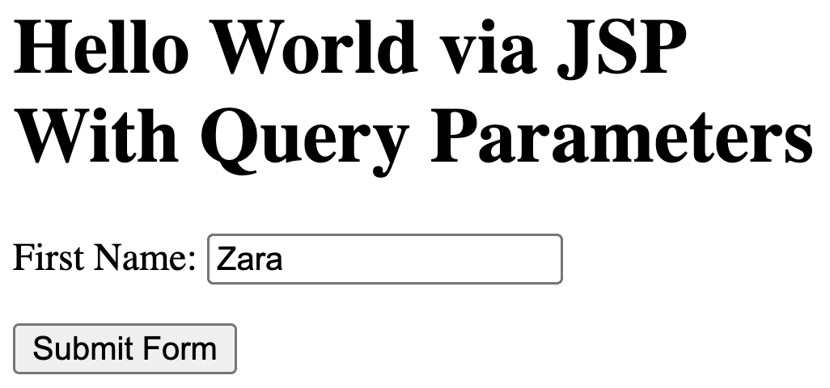
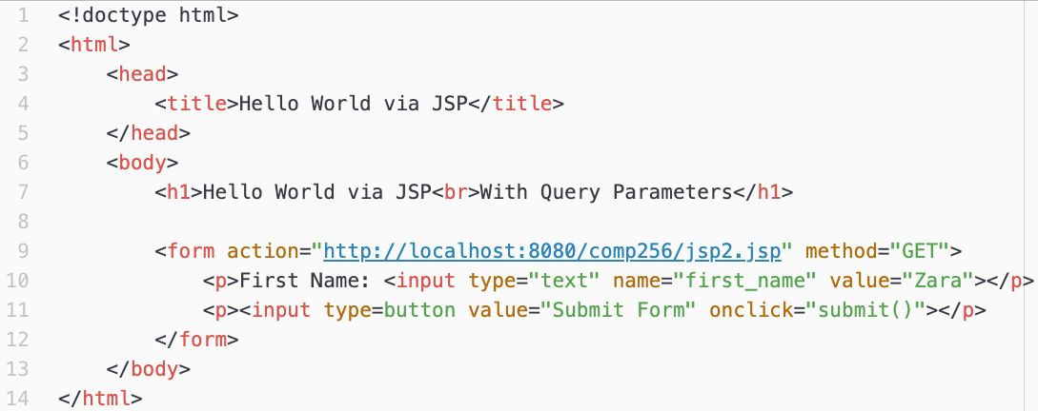
HTML Forms
http://localhost:8080/comp256/jsp2.jsp?first_name=Zara
Notes:
Pasting the URL is not particularly convenient.
HTML forms provide a convenient way to generate requests with query parameters.

Slide 22
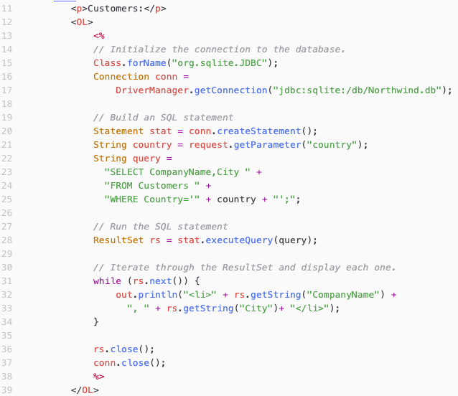
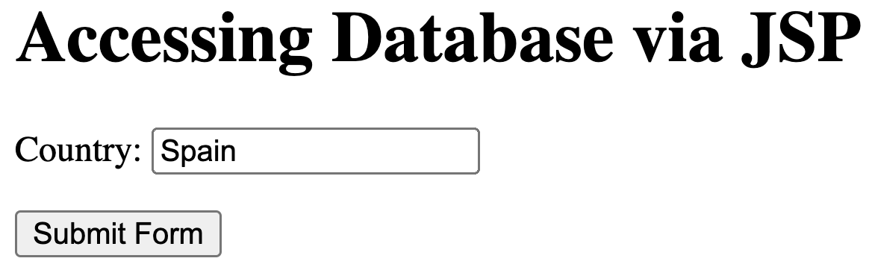
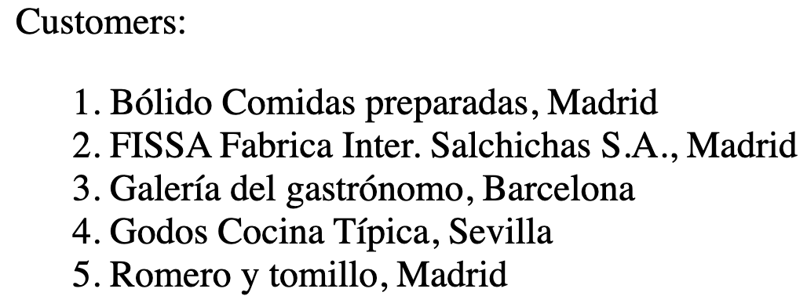
JSP and SQL

Slide 23
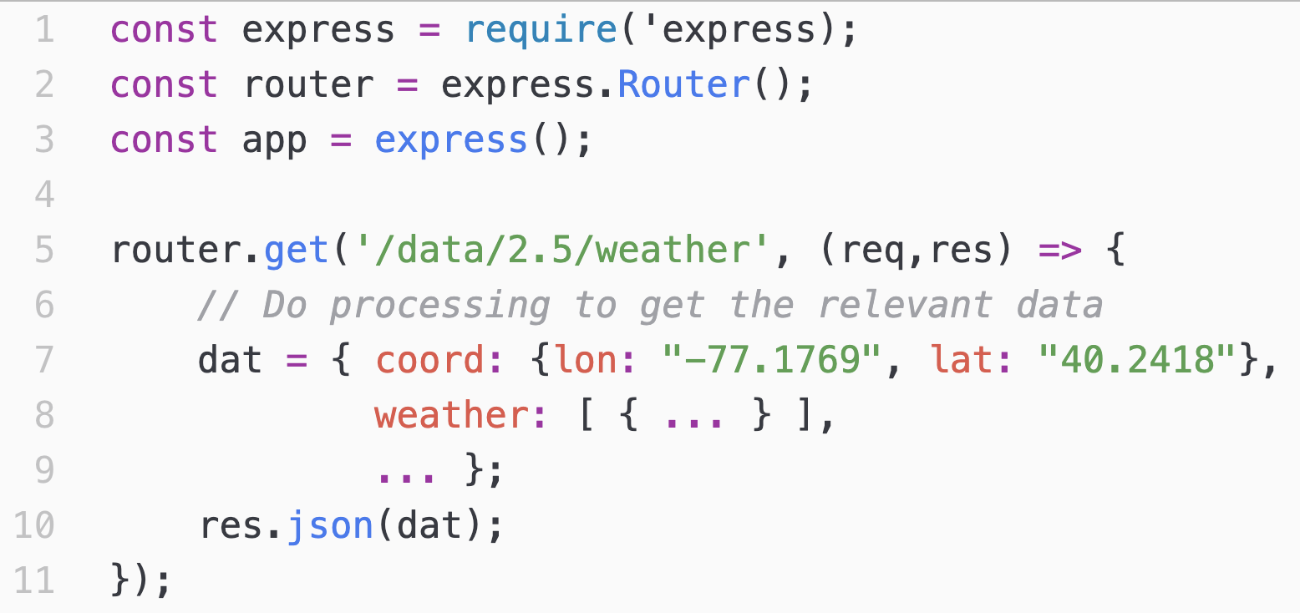
API Endpoint Handlers
In API Endpoint Handling the query string is routed, based on the service, to a function that generates the response.
Node.js/Express (JavaScript)
Laravel (PHP)
Flask / Django (Python)
Spring (Java)
ASP.NET (C#)
Notes:
Routing… complexity hidden from us.
Abstraction:
- All the frameworks just setup routing so that the info gets to the right function,
- And that the response gets sent back to the requestor.
Example of what this looks like in Express.

Slide 24
Server
https://api.openweathermap.org/data/2.5/weather?q=17013,us&appid=71600e803223b59828cade9d4fc4d46b
Service
Query String
Notes:
Endpiont can be broken into two parts:
- server – the name of the web server to send the request to.
- may also hear ”domain”
- Like the restaurant
- service – the specific thing you are asking for from that server.
- Like asking ordering from the bar, the appetizers or the mains
- Each service is a essentially a back-end program that is run by the web server
- The service generates the response and the server returns it to you.

